Slide 1


Roundup of 2016 Labor Law Posting Changes: What Do They Mean for Your Business?
Presented by
Ashley Kaplan,
Sr. Employment Law Attorney for Poster Guard

Slide 2
Roundup of 2016 Labor Law Posting Changes: What Do They Mean for Your Business?
Welcome! Before we get started…
Use the chat box on the left to ask questions
If you are having audio trouble, please message us in the chat box, and we will do our best to assist you
You will receive a copy of the slides via email

Slide 3

About Ashley Kaplan, Esq.
Senior Employment Law Attorney for ComplyRight, Inc.
Also the Director of Legal Content and Labor Law Compliance, overseeing a team of attorneys and human resource professionals responsible for researching, developing and maintaining HR compliance products and Poster Guard services
Has represented employers of all sizes in all areas of labor and employment law, including claims relating to civil rights, family leave issues, wage and hour matters, immigration and breach of contract

Slide 4
Learning Objectives
Overview of top federal and state posting changes and trends for 2016
Rapidly growing city and county posting requirements
Additional federal contractor posting requirements
Poster changes still pending as we enter 2017
Posting compliance for off-site workers

Slide 5
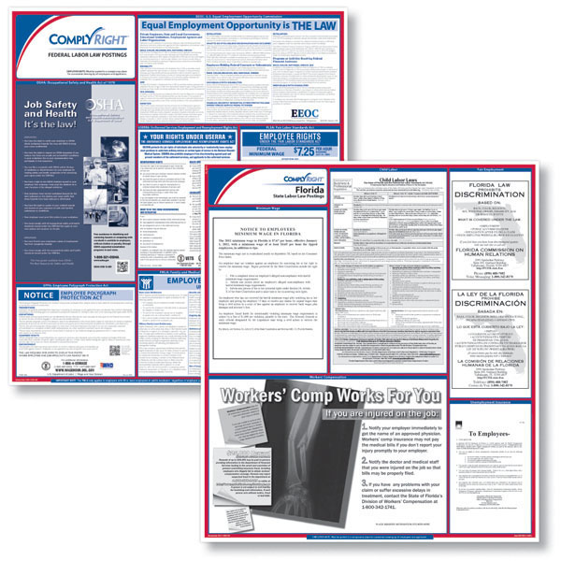
General Posting Compliance

Slide 6
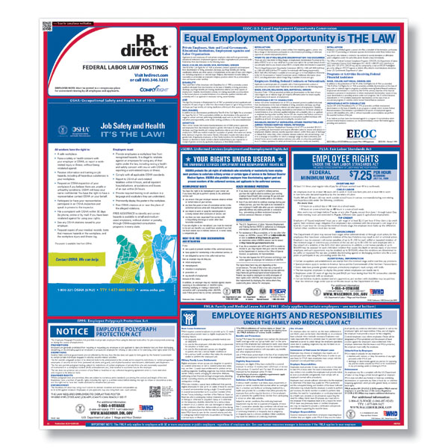
Posting Compliance Basics
All employers must post federal, state and local (if applicable) employee postings
  Six mandatory federal posters
  Up to 15 additional state-specific posters
  Up to 7 additional city/county postings
Additional posters required for certain industries and government contractors
Mandatory federal posters include:
  FLSA/Minimum Wage
  OSHA
  EPPA
  EEOC
  FMLA
  USERRA

Slide 7
No “One-Stop Shop” for Free Government Posters
Nationwide, there are 178 different agencies responsible for issuing more than 370 posters (federal and state)
In a single state, up to 21 postings issued by up to nine different agencies for federal/state compliance
Approximately 22,000 local jurisdictions have authority to issue their own posting requirements
… and that doesn’t include additional posting requirements if you’re in certain industries, have government contracts, or employ non-English speaking employees

Slide 8

Posting Changes on the Rise
Approximately 150 state law poster changes per year (50% require immediate mandatory replacements)
Government agencies don’t notify you when changes occur
Posting updates and requirements (including foreign language requirements and size/font/color mandates) can be buried in statutes, regulations, case law and agency website pages

Slide 9
Risks of Non-Compliance
Government posting fines
  Federal fines recently increased to $30,000+ per violation
  State and local fines typically range from $100-$1,000 each
Employee lawsuits
  Failure to post can extend “statute of limitations”
  Evidence of bad faith
  FMLA interference of rights
Posting compliance is your first line of defense in any lawsuit or agency investigation

Slide 10
2016 Federal Poster Changes
  Occupational Safety and Health Act (OSHA) poster
    Mandatory notification requirement effective August 10, 2016
    (enforcement began December 1, 2016)
  Fair Labor Standards Act (FLSA) poster
    Mandatory poster update effective August 1, 2016
  Employee Polygraph Protection Act (EPPA) poster
    Mandatory poster update effective August 1, 2016

Slide 11

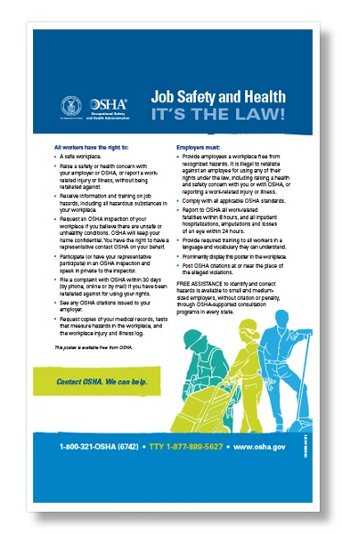
2016 Federal OSHA Poster Change
New OSHA electronic reporting rule issued May 2016
  Employers with 250+ employees (if already required to keep injury and illness records) and with 20-249 employees (in certain high-risk industries) must submit data electronically to OSHA effective July 2017
New rule includes mandatory employee notification requirement
  Must inform employees that they may not be retaliated against for reporting a work-related injury or illness
  Employers may satisfy notification requirement by posting latest OSHA poster (updated version issued on or after April 2015)
  Effective August 10, 2016 (enforcement began 12/1/16)
  Applies to all U.S. private employers, regardless of size or industry
previous poster
updated poster

Slide 12
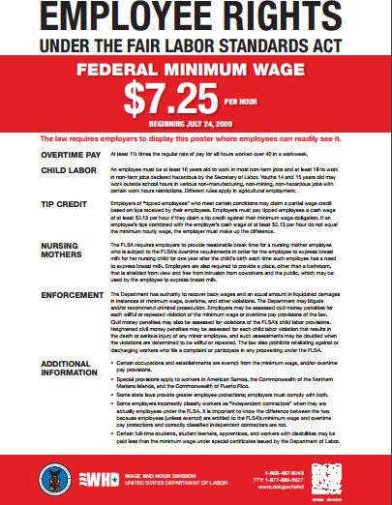
2016 Federal FLSA Poster Change
Mandatory poster change effective August 1, 2016
Applies to virtually all U.S. employers, regardless of employee size or industry
Includes new information about misclassification of independent contractors
Notifies employees of 2010 rule requiring accommodations for nursing mothers
  Part of the Affordable Care Act; amendment to FLSA
  Requires reasonable breaks for employees to express breast milk (for up to one year after child’s birth) in a private location other than the restroom
Incorporates penalty increase based on Civil Penalties Inflation Adjustment Act

Slide 13
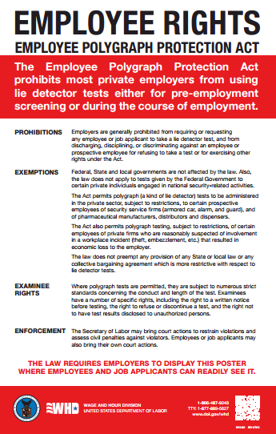
2016 Federal EPPA Poster Change
Mandatory change effective August 1, 2016
Applies to virtually all private U.S. employers, regardless of employee size or industry (even if you do not conduct lie detector tests)
Poster change reflects increased penalties under Civil Penalties Inflation Adjustment Act
Specific penalties removed to allow for ongoing increases based on consumer price index

Slide 14
Pending Federal Poster Changes
Host of proposed legislation and pending federal regulatory activity that could impact labor law posters in 2017
New administration may lead to reduced federal regulatory activity; increased legislation expected at state/local levels
“EEO Is the Law” posting still expected to change
  Mandatory update expected based on 4/8/15 law prohibiting discrimination based on sexual orientation and gender identity, and 3/24/14 law expanding veteran protections
  Not yet known whether new poster will be required for all employers or only federal contractors to replace temporary supplement issued in 2015

Slide 15
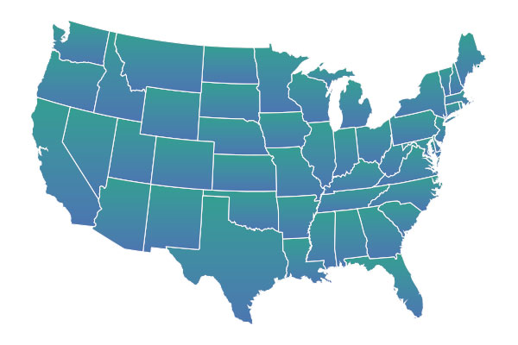
State Labor Law Compliance

Slide 16
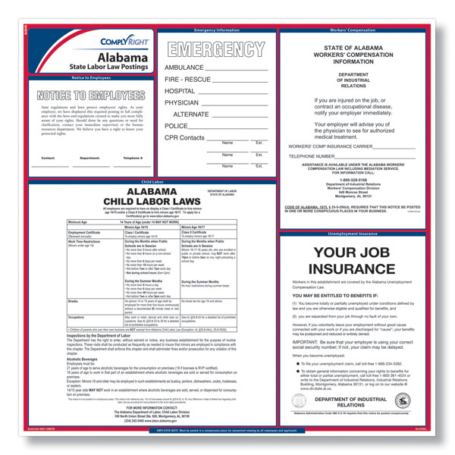
State-Issued Labor Law Posters
Up to 15 state-issued postings required per state, covering issues such as:
  Workers’ Compensation
  Unemployment Insurance
  State Minimum Wage
  Fair Employment
  Family/Medical Leave Benefits
  Smoking in the Workplace
Employers must post both federal and state postings even if there’s conflicting information

Slide 17
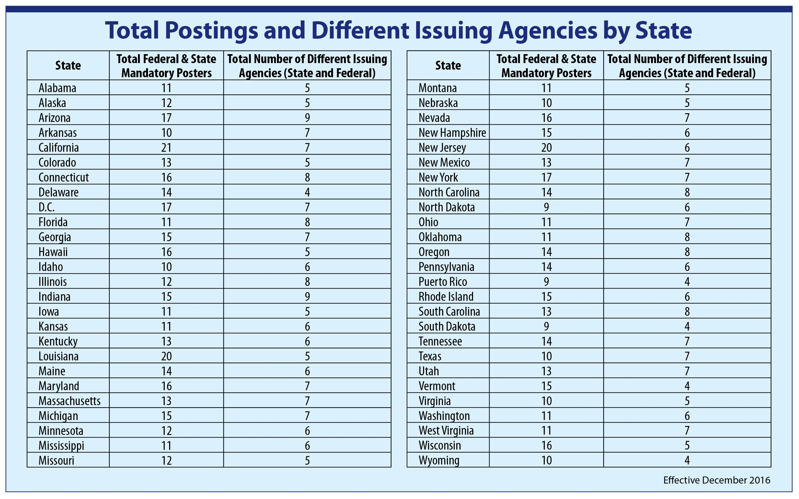

Slide 18
2016 State Poster Changes:
Minimum Wage
Other states had MW increases, but previous versions of posters remained compliant
South Dakota also had an increase but didn’t require a minimum wage posting

Slide 19
State Minimum Wage Increases for 2017:
New Posters Released
  The following states announced minimum wage increases and have already issued new posters:

Slide 20
State Minimum Wage Increases for 2017:
Posters Not Yet Released
  These states announced minimum wage increases, but the new posters haven’t been released yet:
  *Note: There are currently no minimum wage posting requirements for South Dakota or Washington

Slide 21
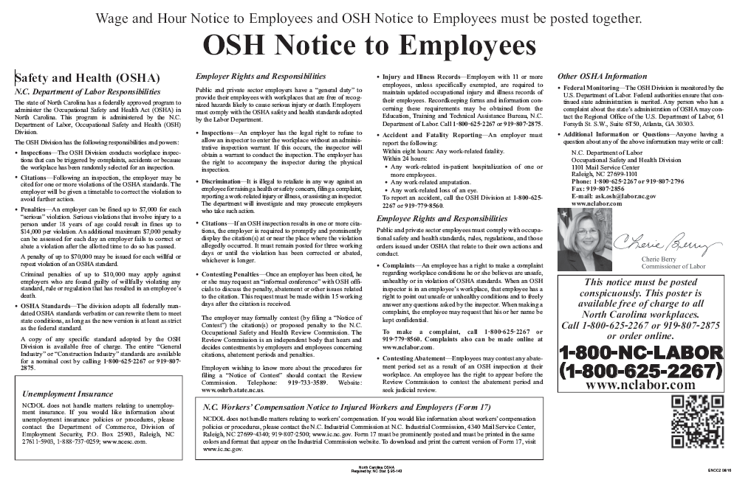
2016 State Poster Changes:
OSHA State Law
The following states updated their state OSHA posters in 2016 to incorporate the new federal OSHA rule requiring employers to inform employees of their right to report work-related injuries and illnesses free from retaliation:
  North Carolina OSHA poster – Mandatory update 8/2016
  Oregon OSHA poster - Mandatory update 10/2016
  Virginia OSHA poster - Mandatory update 10/2016
  Wyoming OSHA poster – Mandatory update 9/2016

Slide 22

2016 State Poster Changes:
Pregnancy Discrimination
Several states passed laws in 2016 targeting pregnancy discrimination and clarifying employer responsibilities to provide reasonable accommodations:
  Colorado - New poster issued August 2016
  Utah – New poster issued September 2016
  West Virginia – Updated poster issued May 2016

Slide 23

City and County Poster Changes

Slide 24

City and County Posting Compliance
Cities have the discretion to pass laws more generous to employees than state or federal law
Postings cover a variety of employment laws similar to state posters, such as:
  Minimum wage
  Paid sick leave
  Prohibitions against discrimination
Employers must post city/county postings even if the city/county posting conflicts with state or federal law

Slide 25
2016 City/County Poster Changes

Slide 26
Local Postings Already Released for 2017

Slide 27
Pending City/County Poster Changes
  Pending poster changes (not yet released) based on laws already enacted:

Slide 28

Federal Contractor Compliance

Slide 29
Federal Contractors Have Additional Posting Obligations
Federal contractor posting obligations depend on the types of contracts you have and, in some cases, the value of the contracts
To determine if you’re a federal contractor for posting purposes, ask yourself:
  Does our business provide goods or services to the federal government or receive federal funding?
  Has our business received federal funds under the American Recovery and Reinvestment Act of 2009?
  Does our business work on federally financed construction projects?
  Is our business required to use E-Verify?

Slide 30
Federal Contractor Postings
The most common postings required for federal contractors are:
  Paid Sick Leave (New! Jan. 2017)
  Minimum Wage (Updated! Jan. 2017)
  “EEO is the Law” Supplement (New! Jan. 2016)
  Pay Transparency Policy (New! Jan. 2016)
  NLRA (required by EO 13496)
  E-Verify/Right to Work
  Walsh-Healey Public/Service Contracts
  ARRA Whistleblower Rights
  DHS Fraud Hotline
  Notice to Workers with Disabilities
  Davis-Bacon Act
  DOT Federal Highway Construction
  DOD Whistleblower
  DOD Fraud Hotline

Slide 31
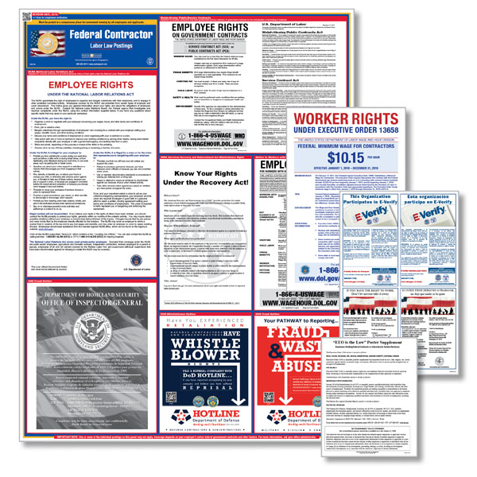
Federal Contractor Postings (cont.)
Federal contractor postings change frequently
  Eight mandatory changes since 2015
  Two already announced for January 2017
  More posting changes pending for 2017
Penalties for non-compliance can be severe, including steep fines up to suspension or cancellation of federal contracts

Slide 32
Compliance for Off-Site Workers

Slide 33


Remote Workers & Telecommuters
By law, you must provide the mandatory federal and state notices to all employees
For employees who report to your facility (with physical wall posters) fewer than 3-4 times per month, you must provide the postings in another format
Electronic solution is ideal for employees who work from home, telecommuters, field salespeople and other remote workers provided with Internet access
Best practice is to use a solution that pushes out mandatory updates via email alerts and tracks employee acknowledgments

Slide 34
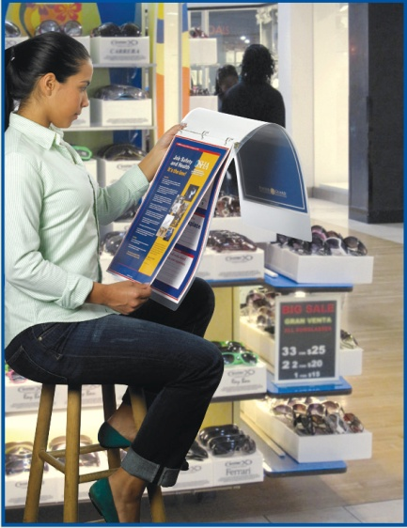
Non-Traditional Worksites
Many of today’s worksites lack adequate wall space for posting all the required federal, state and local postings
Examples are mall kiosks, mobile service units, food trucks, valet stations, construction checkpoints, and other facilities without walls
If electronic access is not provided, consider an alternative format such as a compact binder

Slide 35
Questions?

Slide 36
Thank you!
For more information, please contact Peter Fray, Compliance Specialist
954-970-5702
pfray@hrdirect.com

