Slide 1
New Administration, New Posting Requirements? A Closer Look at the Changing Compliance Climate for Employers
Presented by
Ashley H. Kaplan, Esquire
Sr. Employment Law Attorney for ComplyRight, Inc.

Slide 2
New Administration, New Posting Requirements? A Closer Look at the Changing Compliance Climate for Employers
Welcome! Before we get started…
Use the chat box on the left to ask questions
If you are having audio trouble, please message us in the chat box, and we will do our best to assist you
You will receive a copy of the slides via email

Slide 3
About Ashley Kaplan, Esq.
Senior Employment Law Attorney for ComplyRight, Inc.
Also the Director of Legal Content, overseeing a team of attorneys and human resource professionals responsible for researching, developing and maintaining HR compliance solutions for ComplyRight and Poster Guard Compliance Protection
More than 20 years’ experience representing employers of all sizes in all areas of labor and employment law, including claims relating to civil rights, family leave issues, wage and hour matters, OSHA and immigration

Slide 4
Learning Objectives
How deregulation on the federal level is triggering state and local legislative activity
Key employment law trends (state and local) expected to continue under the new administration
How new state and local legislation is impacting posting requirements
Tips on how to manage your business in this climate of change

Slide 5
Labor Law Posting Compliance Today: The Basics
Up to 21 postings required for federal/state compliance (6 federal, up to 15 per state)
Up to 9 additional postings required by city/county laws
Additional postings required for government contractors and certain industries
No “one-stop shop” for free government posters
170+ different federal/state agencies (up to 9 different agencies per state)
22,000 local jurisdictions have authority to issue their own postings
Posting changes are on the rise; 2017 is already a record year with 63 mandatory changes in 1st quarter
Federal government posting fines were recently increased to $33,000+ per location; non-compliance can also increase liability in civil lawsuits

Slide 6
Poll Question
Do you think the complexity of managing posting compliance has increased over the past few years?

Slide 7
Federal Deregulation May Add Complexity
Even repealed laws can mean updates to policies, postings, training, etc.
Increased state and local legislative activity
Managing business locations in multiple jurisdictions with different laws
More complexity in determining which laws apply to your business when federal/state/local laws conflict
Jurisdiction issues between state and local laws (preemption)
Elevated risk of noncompliance

Slide 8
State and Local Trends to Watch
Minimum Wage
Ban-the-Box
Equal Pay, Wage Transparency & Salary History
Paid Sick Time
Predictable Scheduling & Opportunity to Work
Anti-Discrimination (LGBT)
Weapons in the Workplace
Preemption Laws

Slide 9
Poll Question
Do you expect compliance complexities for employers to increase under the Trump administration?

Slide 10
Minimum Wage
Federal minimum wage $7.25/hour since July 2009
Certain federal contractors must pay $10.20/hour effective 1/1/17 (mandatory poster update)
29 states have higher minimum wage rates than federal law
More than half the states and hundreds of cities have at least one bill pending that will impact minimum wage rates in 2017 and beyond
Most states and cities/counties with minimum wage laws have additional posting requirements
As an employer, you must pay the highest rate that applies, but display all required postings (even if the posters seem to conflict)

Slide 11
Minimum Wage (State Laws)
State | New Minimum Wage | Effective Date
Alaska | $9.80 | January 1, 2017 Mandatory Poster Update
Arizona | $10.00 | January 1, 2017 Mandatory Poster Update
Arkansas | $8.50 | January 1, 2017
California | $10.50 (for employers with 26+ employees) | January 1, 2017 Mandatory Poster Update
Colorado | $9.30 | January 1, 2017 Mandatory Poster Update
Connecticut | $10.10 | January 1, 2017
District of Columbia | $12.50 | July 1, 2017 Mandatory Poster Update
Florida | $8.10 | January 1, 2017 Mandatory Poster Update
Hawaii | $9.25 | January 1, 2017
Maine | $9.00 | January 7, 2017 Mandatory Poster Update
Maryland | $9.25 | July 1, 2017
Massachusetts | $11.00 | January 1, 2017
Michigan | $8.90 | January 1, 2017 Mandatory Poster Update
Missouri | $7.70 | January 1, 2017 Mandatory Poster Update
Montana | $8.15 | January 1, 2017 Mandatory Poster Update
New Jersey | $8.44 | January 1, 2017 Mandatory Poster Update
New York | Variable rates based on location | December 31, 2016 Mandatory Poster Update
Ohio | $8.15 | January 1, 2017 Mandatory Poster Update
Oregon | Variable rates based on location | July 1, 2017
South Dakota | $8.65 | January 1, 2017
Vermont | $10.00 | January 1, 2017
Washington | $11.00 | January 1, 2017

Slide 12
Minimum Wage (Local Laws)
City | New Minimum Wage | Effective Date
California
Cupertino | $12.00 | January 1, 2017 Mandatory Poster Update
El Cerrito | $12.25 | January 1, 2017 Mandatory Poster Update
Los Altos | $12.00 | January 1, 2017 Mandatory Poster Update
Mountain View | $13.00 | January 1, 2017 Mandatory Poster Update
Oakland | $12.86 | January 1, 2017 Mandatory Poster Update
Palo Alto | $12.00 | January 1, 2017 Mandatory Poster Update
Richmond | $12.30 | January 1, 2017 Mandatory Poster Update
San Diego | $11.50 | January 1, 2017 Mandatory Poster Update
San Jose | $10.50 | January 1, 2017 Mandatory Poster Update
San Mateo | $12.00 (for profit employers) | January 1, 2017 Mandatory Poster Update
Santa Clara | $11.10 | January 1, 2017 Mandatory Poster Update
Sunnyvale | $13.00 | January 1, 2017 Mandatory Poster Update
Maine
Portland | $10.68 | January 1, 2017 Mandatory Poster Update
New Mexico
Albuquerque | $8.80 | January 1, 2017 Mandatory Poster Update
Las Cruces | $9.20 | January 1, 2017 Mandatory Poster Update
Washington
Tacoma | $11.15 | January 1, 2017 Mandatory Poster Update

Slide 13
Minimum Wage (2018 Local Increases)
The following have announced minimum wage increases for 2018, but posters have not yet been released:
Cupertino, CA
El Cerrito, CA
Los Altos, CA
Mountain View, CA
Oakland, CA
Palo Alto, CA
Richmond, CA
San Jose, CA
San Mateo, CA
Sunnyvale, CA
Portland, ME
Albuquerque, NM
Bernalillo County, NM
Las Cruces, NM
Seattle, WA
Tacoma, WA

Slide 14
Ban-the-Box
Ban-the-box refers to the question commonly included in job applications: “Have you ever been convicted of a crime?”
Ban-the-box laws seek to protect individuals from being excluded from employment and other opportunities based on their criminal record
Currently 25 states and more than 150 cities/counties have ban-the-box laws in place restricting pre-employment inquiries about criminal history
Some laws restrict criminal background questions until after an interview; some require waiting until a conditional job offer is made

Slide 15
Ban-the-Box (State Laws)
There are currently 25 states that have ban-the box laws in place:
California
Colorado
Connecticut *
Delaware
Georgia
Hawaii *^
Illinois *
Kentucky
Louisiana
Maryland
Massachusetts *^
Minnesota *
Missouri
Nebraska
New Jersey *
New Mexico
New York
Ohio
Oklahoma
Oregon *
Rhode Island *
Tennessee
Vermont *
Virginia
Wisconsin
* Law extends to private employers
^ Mandatory posting requirement

Slide 16
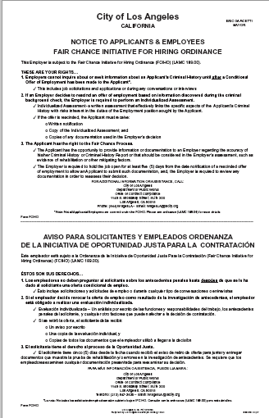
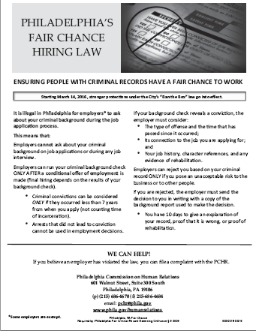
Ban-the-Box (Local Laws)
More than 150 cities/counties have ban-the-box laws in place:
CA: Los Angeles*^, San Francisco*^
CO: Denver
FL: Miami-Dade County, Broward County
GA: Atlanta
MD: Baltimore*, Montgomery County*, Prince George’s County*
MO: Columbia*
NY: Buffalo*, New York City*, Rochester*
OR: Portland*
PA: Philadelphia*^
TX: Austin*
WA: Seattle*^
* Law extends to private employers
^ Mandatory posting requirement

Slide 17
Equal Pay, Wage Transparency & Salary History
States and cities are expanding Equal Pay protections already afforded by federal law
Equal Pay Act (1963), Title VII of the Civil Rights Act (1964), Pay Secrecy for Federal Contractors (2016)
“Wage Transparency” laws prohibit employers from discriminating or retaliating against employees for discussing their wages with coworkers
Pending legislation in Florida, Hawaii, Montana, Washington and many cities/counties
“Salary History” laws restrict employers from asking job applicants about salary history
Massachusetts, Puerto Rico, Philadelphia and NYC have laws in place for private employers
Pending legislation in California, Connecticut, Texas and many cities/counties
Equal Pay mandatory postings in Georgia, Maryland, New Hampshire, Pennsylvania

Slide 18
Paid Sick Time
Currently, there are limited federal requirements for sick leave
Family and Medical Leave Act (1993) provides unpaid leave for up to 12 weeks for “serious health condition”
Exec Order 13706 (2017) provides up to 7 days per year of paid sick leave for certain employees of federal contractors (new mandatory posting effective 1/1/17)
States and cities are passing their own laws requiring private employers to offer paid sick leave
Seven states and Washington D.C. currently have paid sick leave laws
More than 25 cities and counties have paid sick leave laws
Several states and cities have pending legislation

Slide 19
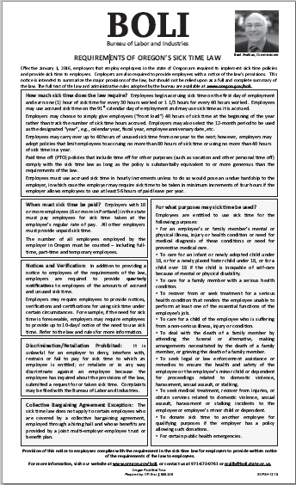
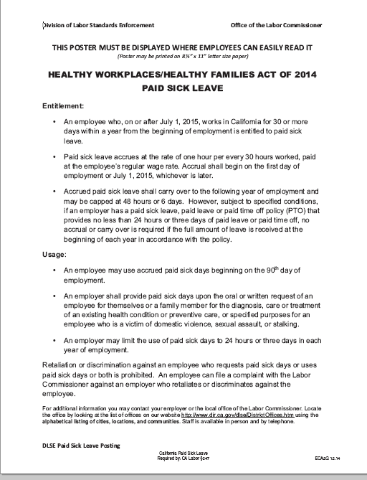
Paid Sick Time (State Laws)
Seven states and Washington D.C. currently have paid sick leave laws:
Arizona *
California *
Connecticut *
District of Columbia *
Massachusetts *
Oregon *
Vermont *
Washington
* Mandatory posting requirements

Slide 20
Paid Sick Time (Local Laws)
More than 25 cities and counties have paid sick leave requirements:
CA: Berkeley, Emeryville, Los Angeles, Oakland, San Diego, San Francisco, Santa Monica
IL: Chicago
MD: Montgomery County
MN: Minneapolis, St. Paul
NJ: Bloomfield, East Orange, Elizabeth, Irvington, Jersey City, Montclair Morristown, Newark, New Brunswick, Passaic, Paterson, Trenton
PA: Philadelphia
WA: Seattle, Spokane, Tacoma
All of the above have mandatory posting requirements

Slide 21
Poll Question
Has increased state/local legislation created challenges with consistency across your business locations?

Slide 22
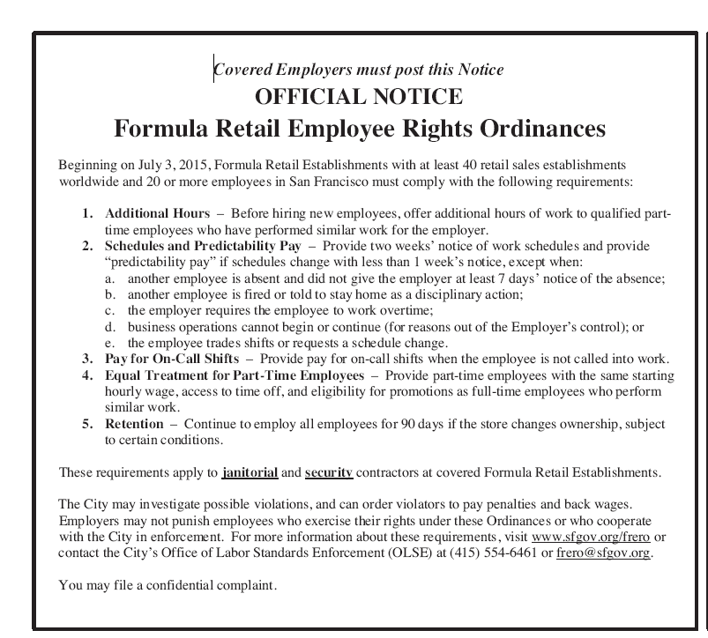
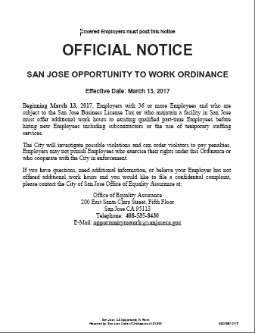
Predictable Scheduling & Opportunity to Work
Predictable Scheduling Laws – require employers to provide employees with advance notice of their schedule and, in some instances, compensate employees for last-minute changes
Laws passed in San Francisco, Emeryville, Seattle
Pending legislation in California, Minnesota, and NYC
Expected to include posting requirements
Opportunity to Work Laws – require employers to offer additional work hours to existing part-time employees before hiring new employees
Laws passed in San Jose (all industries) and San Francisco (industry-specific)
Both require mandatory postings

Slide 23
Anti-Discrimination
Federal law (Title VII of the Civil Rights Act of 1964) doesn’t specifically prohibit discrimination on the basis of sexual orientation or gender identity
Executive Order 11246, as amended, now includes these protections but only for federal contractors (effective April 2015)
7th Circuit recognized sexual orientation discrimination under federal law in landmark case on April 4, 2017
About 20 states and more than 200 cities/counties have LGBT anti-discrimination laws in place; many more state and local laws pending
Mandatory posting requirements in: California, Colorado, Connecticut, District of Columbia, Delaware, Hawaii, Massachusetts, Maryland, New Hampshire, New Jersey, New Mexico, Nevada, New York, Rhode Island, Wisconsin

Slide 24
Poll Question
How confident are you that your locations are in compliance with city/county posting requirements?

Slide 25
Weapons in the Workplace
Federal law generally does not regulate firearms at work
More than 15 states have “parking lot” laws including: Arizona, Florida, Georgia, Illinois, Indiana, Kentucky, Louisiana, Maine, Minnesota, Mississippi, North Carolina, Ohio, Tennessee, Texas, Utah, Wisconsin
Several states require employers to post notices to prohibit guns at work:
Arkansas
District of Columbia
Illinois
Kansas
Minnesota
Mississippi
Missouri
Nebraska
North Carolina
South Carolina
Tennessee
Texas

Slide 26
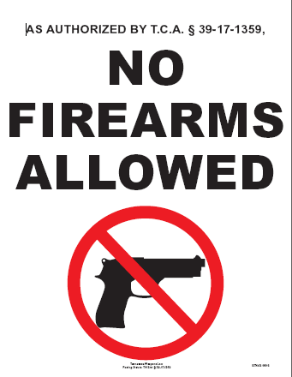
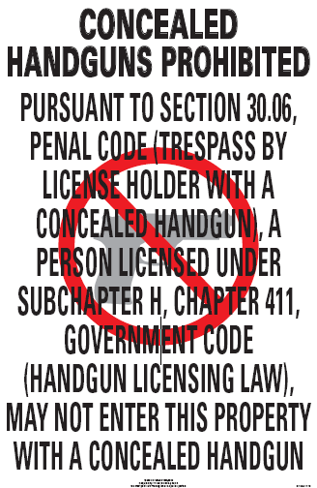
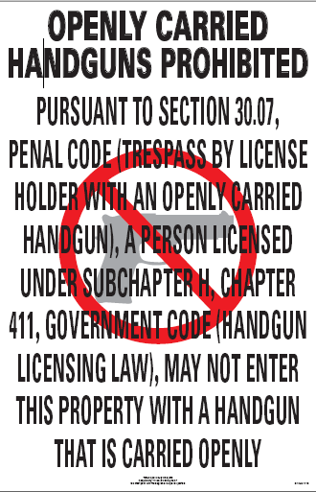
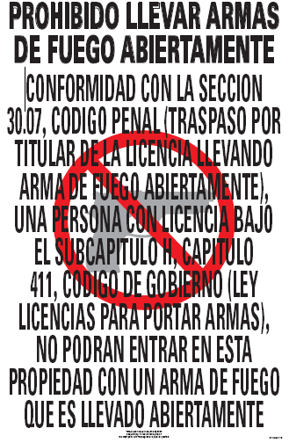
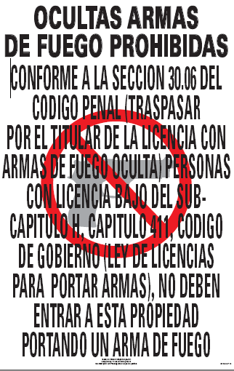
Weapons in the Workplace (continued)
Tennessee No-Weapons Poster:
Texas No-Weapons Posters:

Slide 27
Preemption Laws
“Preemption laws” are state laws that prohibit cities from imposing requirements on employers that are more restrictive than under existing federal and state law
27 states preempt local minimum wage ordinances
19 states preempt local paid leave ordinances
3 states preempt local anti-discrimination ordinances
Preemption bills now pending in Florida, Indiana, Iowa, Kansas, Minnesota, Oklahoma, Oregon, Pennsylvania, South Carolina, Tennessee, Texas
Local ordinances also may be preempted through court decisions
Adds to the complexity of compliance and creates confusion; many local laws have been repealed after the employer has implemented them

Slide 28
Tips to Manage Your Business
Here are some tips to help you navigate in this climate of change:
Conduct an internal audit of all employment practices to ensure compliance with federal, state and local regulations
Follow the provisions of each applicable law that are most generous to the employee
Address any areas that require policy adjustments
Consider uniform practices across locations (consistency vs. cost)
Display local postings in addition to mandatory federal and state postings, even if the information conflicts
Assign internal resources or use an outsourced partner for posting compliance to stay abreast of changing federal, state and local laws

Slide 29
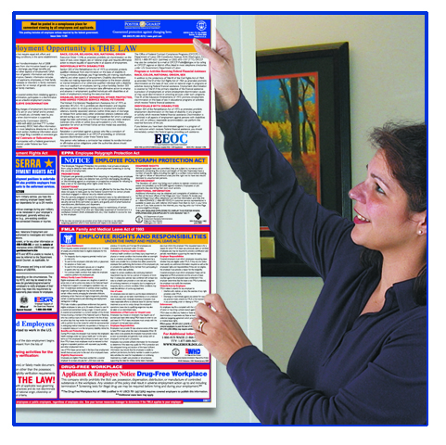
Poster Guard Compliance Protection Federal/State/Local Service
To start, each of your locations will receive a complete federal, state and local poster set (coverage for every city and county in the U.S.)
Our in-house Legal Team then continually monitors all federal, state and local legislation and regulatory activity
Automatic poster replacements are sent immediately whenever there’s a mandatory change
100% compliance guarantee against government posting fines
Additional solutions available for remote/off-site workers, federal contractors, applicants, Canada, industry variations and more

Slide 30
Questions?

Slide 31
Thank you!
For more information, please contact Peter Fray, Compliance Specialist
954-970-5702
pfray@hrdirect.com

